Slide 1
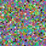
A Concurrent Implementation for Genetic Algorithms
Nick Knowles (knowlen@wwu.edu)
Western Washington University

Slide 2
Presentation Overview
Algorithm overview
Motivation for concurrency
Image approximation results
Continued work

Slide 3
Genetic Algorithms
Random init
Mimics biological evolution and natural selection to evolve a population of "candidate solutions" towards a global optimum for some underlying task or goal.
Evaluation
Evaluation
Crossover/Mutation
Selection

Slide 4
Genetic Algorithms
Random init
Create a population vector, P of randomly initialized "candidate solutions"
Evaluation
Evaluation
[18, 5, 56, 1]
P =
[42, 1, 35, 12]
[ 3, 27, 83, 7]
.
.
.
Crossover/Mutation
Selection
[..., ..., ..., ...]

Slide 5
Genetic Algorithms
For each c in P:
run c through target
function and store
how well it does
Random init
Create a population vector, P of randomly initialized "candidate solutions"
Evaluation
Evaluation
Evaluation
[18, 5, 56, 1]
P =
[42, 1, 35, 12]
[ 3, 27, 83, 7]
.
.
.
Crossover/Mutation
Selection
[..., ..., ..., ...]

Slide 6
Genetic Algorithms
For each c in P:
run c through target
function and store
how well it does
Sample a pseudo random set of candidates from P, biased towards higher evaluation scores
Random init
Create a population vector, P of randomly initialized "candidate solutions"
Evaluation
Evaluation
[18, 5, 56, 1]
P =
[42, 1, 35, 12]
[ 3, 27, 83, 7]
.
.
.
Crossover/Mutation
Selection
Selection
[..., ..., ..., ...]

Slide 7
Genetic Algorithms
For each c in P:
run c through target
function and store
how well it does
Sample a pseudo random set of candidates from P, biased towards higher evaluation scores
Random init
Create a population vector, P of randomly initialized "candidate solutions"
Evaluation
Evaluation
[18, 5, 56, 1]
P =
[42, 1, 35, 12]
[ 3, 27, 83, 7]
Generate a random bit mask of length len(c), apply mask and XOR(mask) to two "parent" candidates and sum them to create two "child" candidates
.
.
.
Crossover &
Mutation
Crossover/Mutation
Selection
[..., ..., ..., ...]

Slide 8
Genetic Algorithms
For each c in P:
run c through target
function and store
how well it does
Sample a pseudo random set of candidates from P, biased towards higher evaluation scores
Random init
Create a population vector, P of randomly initialized "candidate solutions"
Evaluation
Evaluation
[18, 5, 56, 1]
P =
[42, 1, 35, 12]
[ 3, 27, 83, 7]
Generate a random bit mask of length len(c), apply mask and XOR(mask) to two "parent" candidates and sum them to create two "child" candidates
Eg; mask = [0, 1, 0, 1]
P1 = [5, 3, 7, 1]
P2 = [6, 8, 2, 4]
C1 = [5, 8, 7, 4]
C2 = [6, 3, 2, 1]
.
.
.
Crossover &
Mutation
Crossover/Mutation
Selection
[..., ..., ..., ...]

Slide 9
Genetic Algorithms
For each c in P:
run c through target
function and store
how well it does
Sample a pseudo random set of candidates from P, biased towards higher evaluation scores
Random init
Create a population vector, P of randomly initialized "candidate solutions"
Evaluation
Evaluation
[18, 5, 56, 1]
P =
[42, 1, 35, 12]
[ 3, 27, 83, 7]
Generate a random bit mask of length len(c), apply mask and XOR(mask) to two "parent" candidates and sum them to create two "child" candidates
Eg; mask = [0, 1, 0, 1]
P1 = [5, 3, 7, 1]
P2 = [6, 8, 2, 4]
C1 = [5, 8, 7, 4]
C2 = [6, 3, 2, 1]
C1 = [7, 8, 7, 4]
.
.
.
Crossover &
Mutation
Crossover/Mutation
Selection
[..., ..., ..., ...]
Every child has a small chance to mutate in some random way:

Slide 10
Genetic Algorithms
For each c in P:
run c through target
function and store
how well it does
Sample a pseudo random set of candidates from P, biased towards higher evaluation scores
Random init
Create a population vector, P of randomly initialized "candidate solutions"
Evaluation
Replacing parents
Evaluation
[18, 5, 56, 1]
P =
[42, 1, 35, 12]
[ 3, 27, 83, 7]
Generate a random bit mask of length len(c), apply mask and XOR(mask) to two "parent" candidates and sum them to create two "child" candidates
Eg; mask = [0, 1, 0, 1]
P1 = [5, 3, 7, 1]
P2 = [6, 8, 2, 4]
C1 = [5, 8, 7, 4]
C2 = [6, 3, 2, 1]
C1 = [7, 8, 7, 4]
.
.
.
Crossover &
Mutation
Crossover/Mutation
Selection
[..., ..., ..., ...]
Every child has a small chance to mutate in some random way:

Slide 11
Need for Concurrency
This can take seconds, hours, or days depending on the problem
Random init
Evaluation
Evaluation
Evaluation
> Many problems have very large evaluation times.
> Need to evaluate on 100s or 1000s of candidate solutions at each iteration.
> Bayesian optimization or Simulated Annealing favored over Genetic Algs because of this (despite comparable precision).
Crossover/Mutation
Selection

Slide 12



Executive Summary
Random init
My implementation uses multiprocessing (because Python...) to perform these evaluations in parallel.
Evaluation
This allows the algorithm to complete more evaluations per wallclock time, and allows it to scale with iterations (epochs) at a more reasonable rate.
Evaluation
Evaluation
I apply the algorithm to the task of image approximation. Starting with a population of randomly generated NumPy arrays, and evolving towards a specified target image.
Crossover/Mutation
Selection

Slide 13
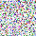
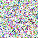
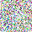
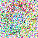
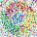
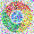
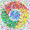
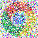







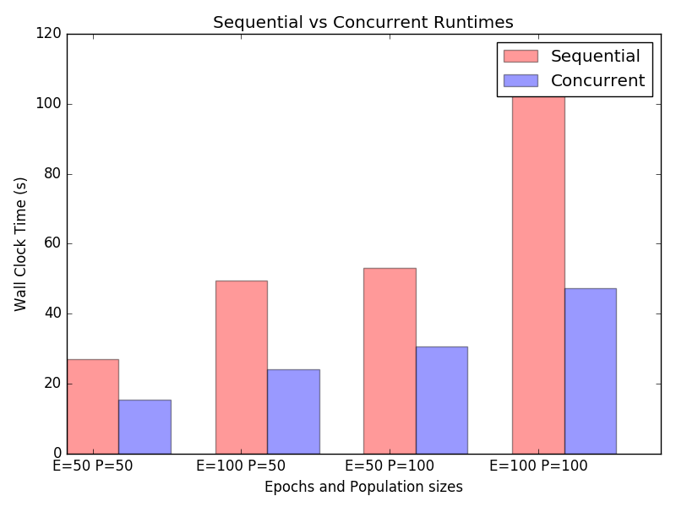


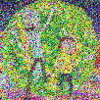
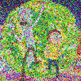
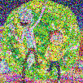
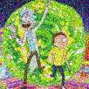

Results (Preliminary)
Runtimes key
26.930s | 49.678s | 53.150s | 1m43.949s
15.532s | 24.156 | 30.727 | 47.233s

Slide 14
Next steps...
> Extend concurrent elements of the Python code with C++.
> Experiment over a wider range of hyperparameters.
> Implement different different selection & replacement algorithms.
> Look into distributed computing methods for larger problems (eg; dispatch concurrent evaluations to every computer on some cluster).
> Apply to more practical domains.

Slide 15



Thanks!
/knowlen

